Slide 1
Introducing WinSCP
WinSCP is an open source free SFTP client, FTP client, WebDAV client and SCP client for Windows. Its main function is file transfer between a local and a remote computer. Beyond this, WinSCP offers scripting and basic file manager functionality.

Slide 2
WinSCP Transfer protocols
WinSCP supports four Transfer Protocols:
SFTP (SSH File Transfer Protocol)
FTP (File Transfer Protocol)
SCP (Secure Copy Protocol)
WebDAV (Web Distributed Authoring and Versioning).
An SFTP client is a software which uses the SFTP protocol to transfer files securely to and from a remote computer.
Source : https://winscp.net/eng/docs/protocols
Source : https://winscp.net/eng/docs/library_install#gac

Slide 3
WinSCP .NET Assembly and COM Library
The WinSCP .NET assembly winscpnet.dll is a .NET wrapper around WinSCP’s scripting interface that allows your code to connect to a remote machine and manipulate remote files over SFTP, FTP, WebDAV and SCP sessions from .NET languages, such as C#, VB.NET, and others, or from environments supporting .NET, such as PowerShell, SQL Server Integration Services (SSIS), ASP.NET and Microsoft Azure Website.
The assembly is also exposed to COM, and as such it can be used from variety of other programming languages and development environments–e.g., WSH-hosted active scripting languages like JScript and VBScript, Visual Basic for Applications (VBA), Perl, and Python.

Slide 4
Purpose of the Assembly
The library is primarily intended for advanced automation tasks that require conditional processing, loops or other control structures for which the basic scripting interface is too limited. The library is not a general purpose file transfer library. It particularly lacks support for interactive processing and as such it is not well suited for use in GUI applications.
As the assembly drives WinSCP Windows executable, it cannot be used in .NET Core projects.

Slide 5
Using WinSCP .NET Assembly from SQL Server Integration Services (SSIS)
Install the WinSCP .NET assembly.
Install the assembly to the GAC(Global Assembly Cache).
Use it from SSIS script Component
Deploying WinSCP .NET Assembly
Example C# Script Task Code
Source : https://winscp.net/eng/docs/library_ssis#example

Slide 6
How to Use it from SSIS
You use WinSCP .NET assembly from SSIS as any other .NET assembly:
In Microsoft Visual Studio2), in your “Integration Services Project”,
choose your “SSIS Package” (e.g. the default Package.dtsx);
Drag Script task from Toolbox onto Control flow view of the package;
In the context menu of the task, choose Edit;
On the Script task editor on Script page, click Edit script button;
Visual Studio Tools for Applications is run to edit the script;
Use Project > Add Reference > Browse to add reference to winscpnet.dll;
Place your C# or VB.NET code into ScriptMain.Main method
Close Visual Studio Tools for Applications and Script task editor with OK button.

Slide 7
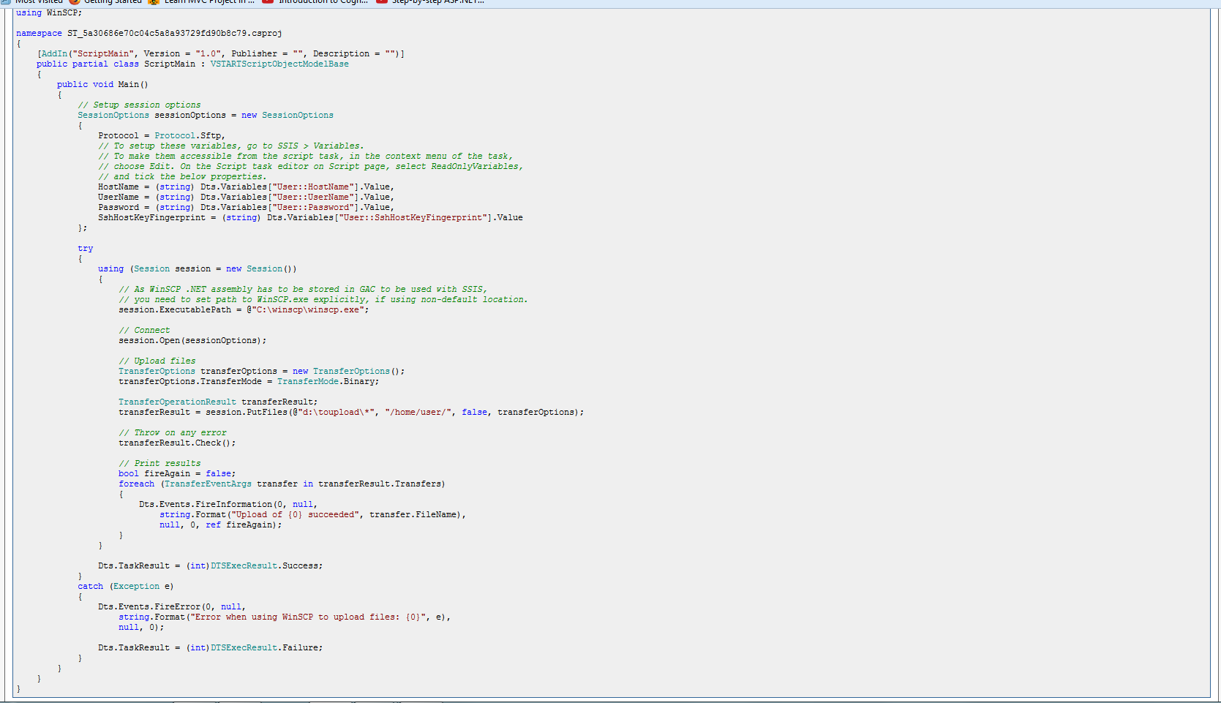

Slide 8
Deploying WinSCP .NET Assembly
When deploying your SSIS package, WinSCP .NET assembly should be installed to GAC to be accessible.
Alternatively, you can subscribe AppDomain.AssemblyResolve event in a static constructor handler of the script task class to locate the assembly in an another location.

Slide 9
Watching for changes in SFTP/FTP server
Neither SFTP nor FTP protocol have any mechanism to notify a client about changes in a remote folder.
The only solution to detect changes is to periodically enumerate remote directory tree and find differences. It’s easy to implement with use of Session.EnumerateRemoteFiles method and Compare-Object cmdlet in PowerShell or Enumerable.Except LINQ method in C#/VB.NET.

Slide 10
SSIS Best Practices
Best Practice #1 - Pulling High Volumes of Data
Best Practice #2 - Avoid SELECT *
Best Practice #3 - Effect of OLEDB Destination Settings
Best Practice #4 - Effect of Rows Per Batch and Maximum Insert Commit Size Settings
Best Practice #5 - SQL Server Destination Adapter
Best Practice #6 - Avoid asynchronous transformation (such as Sort Transformation) wherever possible
Best Practice #7 - DefaultBufferMaxSize and DefaultBufferMaxRows
Best Practice #8 - BufferTempStoragePath and BLOBTempStoragePath
Best Practice #9 - How DelayValidation property can help you
Best Practice #10 - Better performance with parallel executionBest Practice
Best Practice #11 - When to use events logging and when to avoid...
Best Practice #12 - Monitoring the SSIS Performance with Performance Counters
Best Practice #13 - Distributed Transaction in SSIS and its impact...
Best Practice #14 - How Checkpoint features helps in package restarting

Slide 11
Source:
https://winscp.net/eng/docs/library_example_watch_for_changes
https://winscp.net/eng/docs/start : Total Documentation

Slide 12
Thank you !!

